Slide 1


Gopi
February 28, 2026

Slide 2

Outline
Executive Summary
Introduction
Methodology
Results
Conclusion
Appendix

Slide 3
Executive Summary
Project Overview: https://github.com/gopikrishnan-t-s/Applied-Data-Science-Capstone
Analyzed historical SpaceX launch data to evaluate operational performance and mission success
Methodology:
• Data cleaning, normalization, and validation
• SQL-based exploratory data analysis (aggregations, success rates, temporal trends)
• Visualization of payload, booster, and site performance
• Predictive modeling using supervised classification
Key Results:
Launch frequency increased significantly over time
Year-over-year reliability improvements observed
Booster version and payload mass influence mission success probability
Launch site performance differences identified

Slide 4
Introduction
Project Background & Context:
• Commercial space launch industry has experienced rapid growth and increased competition.
• SpaceX has significantly expanded launch cadence and reusable rocket operations.
• Reliable mission execution is critical for cost efficiency, customer trust, and operational scalability.
Business & Analytical Context:
• Large volumes of historical launch data provide opportunity for quantitative performance analysis.
• Structured data enables statistical evaluation of reliability, operational trends, and risk factors.
Key Questions / Problems to Address:
• What factors most influence mission success probability?
• How has launch reliability evolved over time?
• Do specific booster versions or launch sites perform better?
• Does payload mass correlate with mission outcome?
• Can historical data support predictive modeling of future launches?

Slide 5

Section 1

Slide 6
Methodology
Data collection methodology
Performed data wrangling
Performed exploratory data analysis (EDA) using visualization and SQL
Performed interactive visual analytics using Folium and Plotly Dash.
Performed predictive analysis using classification models

Slide 7
Data Collection- SPACEX API and Web Scrape
Objective: Gather and organize launch data for SpaceX Falcon 9 and Falcon Heavy missions.
Sources: Wikipedia launch tables, SpaceX API, and official press releases.
Data Retrieval
Perform HTTP GET requests to the designated URLs or API endpoints.
Utilize BeautifulSoup to parse HTML tables.
Process JSON data returned from the API.
Header Extraction
Retrieve column headers from <th> elements in HTML or keys within JSON objects.
Clean and standardize header names by removing excess whitespace.
Row Extraction
Iterate through <tr> elements in HTML or arrays within JSON data.
Extract details such as payload, launch site, date, flight number, and mission outcome.
Manage any missing or incomplete values appropriately.

Slide 8
Data Collection continued
Data Preparation & Conversion
Transform payload mass and flight number into numeric formats.
Parse date strings into datetime objects.
Encode categorical results:
Success as 1 and
Failure as 0.
​
Data Storage & Output
Save the data within a Pandas DataFrame.
Optionally export to CSV, Excel, or a database.

Slide 9
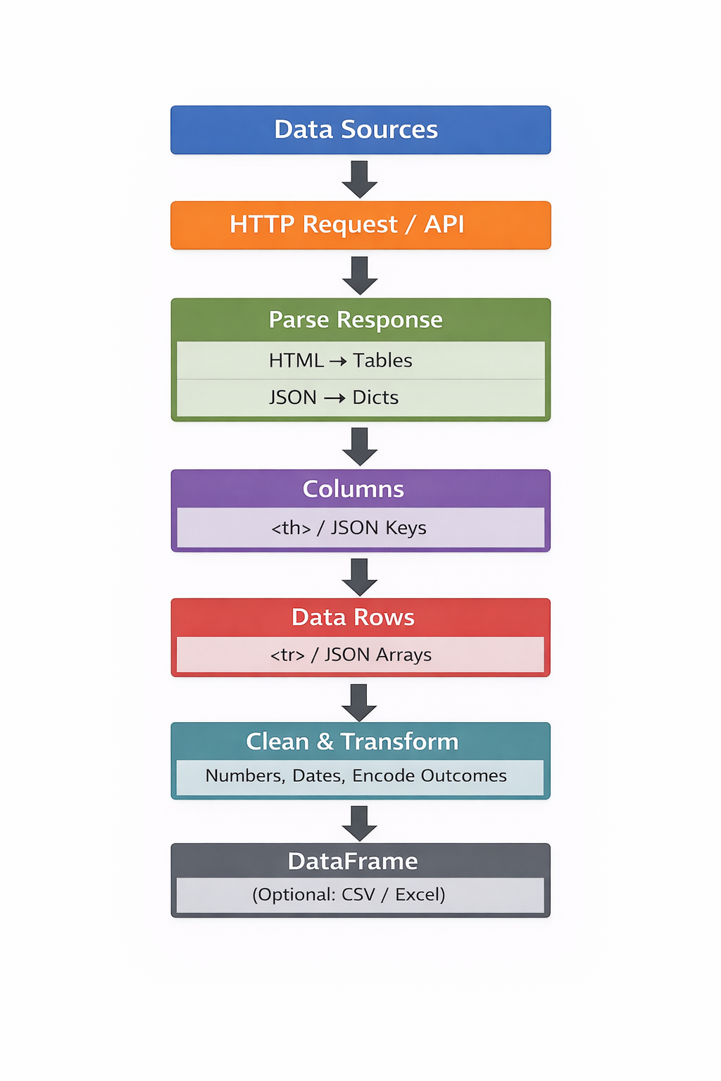
Data Collection- Flowchart
https://github.com/gopikrishnan-t-s/Applied-Data-Science-Capstone/blob/main/SpaceX_Data_Collection_API.ipynb

Slide 10
Data Wrangling
Raw DataFrame
Original collected data from web scraping or API
Handle Missing Values
Drop rows with missing values or fill with placeholders
Convert Data Types
Convert payload, flight number to numeric
Convert date columns to datetime
Ensure categorical columns are of type 'category'
Standardize Formats
Normalize text fields (strip whitespace, fix casing)
Standardize launch site names

Slide 11
Data Wrangling - continued
Encode Categorical Variables
Encode Mission Outcome: Success = 1, Failure = 0
Booster Version: one-hot or label encoding
Feature Engineering
Extract month/year from date for analysis
Create new features: payload ranges, success rates per booster
Filter / Remove Outliers
Identify unrealistic payloads or flight numbers
Remove or cap extreme values
Aggregate & Summarize
Group by launch site, booster version, or year
Compute counts, averages, success rates

Slide 12
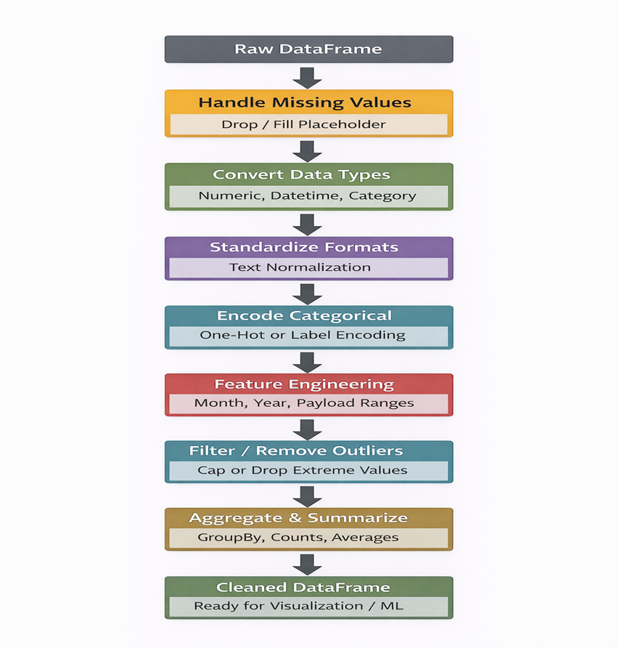
Data Wrangling - Flowchart
https://github.com/gopikrishnan-t-s/Applied-Data-Science-Capstone/blob/main/SpaceX_Data_Wrangling.ipynb

Slide 13
EDA with Data Visualization
Explore and visualize SpaceX launch data to identify patterns, relationships, and trends
Dataset Summary
Check data types and missing values
Compute descriptive statistics (df.describe())
Purpose: Ensure data is clean and ready for analysis
Univariate Analysis
Histograms: Numeric distributions (Payload Mass, Flight Number) → detect skewness and outliers
Boxplots: Identify spread and extreme values
Bar / Pie Charts: Categorical frequencies (Mission Outcome, Launch Site) → understand proportion of categories

Slide 14
EDA with Data Visualization - continued
Bivariate / Multivariate Analysis
Scatter plots: Flight Number vs Payload Mass → explore correlations and trends
Boxplots: Payload Mass vs Mission Outcome → compare distributions across categories
Correlation heatmap: Identify relationships between numeric features

Slide 15
EDA with SQL – Task 1
Objective of SQL-Based EDA
Use structured queries to explore, summarize, and validate SpaceX launch data
Extract statistical insights prior to visualization and modeling
Identify trends, distributions, performance metrics, and data quality issues
Task 1: Display the names of the unique launch sites
SQL query: """ SELECT DISTINCT Launch_siteFROM SPACEXTABLEORDER BY Launch_site;"""cur.execute(query)unique_sites = cur.fetchall()unique_sites

Slide 16
EDA with SQL – Task 2 and Task 3
Task 2- Display 5 records where launch sites begin with the string 'CCA’
Query:
""" SELECT * FROM SPACEXTABLEWHERE Launch_Site LIKE 'CCA%'LIMIT 5; """cur.execute(query)rows = cur.fetchall()df_cca = pd.DataFrame(rows,columns=df.columns)df_cca
Task 3 - Display the total payload mass carried by boosters launched by NASA (CRS)
Query:
""" SELECT SUM("PAYLOAD_MASS__KG_") AStotal_payload_massFROM "SPACEXTABLE"WHERE Customer = 'NASA (CRS)'; """cur.execute(query)total_payload = cur.fetchone()total_payload

Slide 17
EDA with SQL – Task 4 and Task 5
Task 4- Display average payload mass carried by booster version F9 v1.1
Query: """ SELECT AVG(PAYLOAD_MASS__KG_) ASavg_payload_massFROM SPACEXTABLEWHERE Booster_Version LIKE 'F9 v1.1%'; """ cur.execute(query)avg_payload = cur.fetchone()avg_payload
Task 5 - List the date when the first succesful landing outcome in ground pad was acheived.
Query:
""" SELECT MIN(Date) ASfirst_success_ground_padFROM SPACEXTABLEWHERE "Landing_Outcome" = 'Success (ground pad)';"""cur.execute(query)first_success = cur.fetchone()first_success

Slide 18
EDA with SQL – Tasks 6 and 7
Task 6 - List the names of the boosters which have success in drone ship and have payload mass greater than 4000 but less than 6000
Query:
"""SELECT DISTINCT "Booster_Version"FROM SPACEXTABLEWHERE "Landing_Outcome" LIKE 'Success (drone ship)' AND "PAYLOAD_MASS__KG_" > 4000 AND "PAYLOAD_MASS__KG_" < 6000;"""cur.execute(query)boosters = cur.fetchall()#import pandas as pdpd.DataFrame(boosters, columns=["Booster_Version"])
Task 7 - List the total number of successful and failure mission outcomes
Query:
"""SELECT "Mission_Outcome", COUNT(*) AS countFROM SPACEXTABLEGROUP BY "Mission_Outcome";"""cur.execute(query)mission_counts = cur.fetchall()# import pandas as pdpd.DataFrame(mission_counts, columns=["Mission_Outcome", "Count"])

Slide 19
EDA with SQL – Tasks 8 and 9
Task 8 - List all the booster_versions that have carried the maximum payload mass, using a subquery with a suitable aggregate function
Query:
"""SELECT "Booster_Version", "PAYLOAD_MASS__KG_"FROM SPACEXTABLEWHERE "PAYLOAD_MASS__KG_" = ( SELECT MAX("PAYLOAD_MASS__KG_") FROM SPACEXTABLE);"""cur.execute(query)max_payload_boosters = cur.fetchall()# pandas as pdpd.DataFrame(max_payload_boosters, columns=["Booster_Version", "PAYLOAD__MASS_KG_"])
Task 9 - List the records which will display the month names, failure landing_outcomes in drone ship ,booster versions, launch_site for the months in year 2015.
Query:
"""SELECT substr(Date, 6, 2) AS Month, "Booster_Version", "Landing_Outcome", "Launch_Site"FROM SPACEXTABLEWHERE "Landing_Outcome" LIKE 'Failure (drone ship)' AND substr(Date, 1, 4) = '2015';"""cur.execute(query)failures_2015 = cur.fetchall()pd.DataFrame(failures_2015, columns=["Month", "Booster_Version", "Landing_Outcome", "Launch_Site"])

Slide 20
EDA with SQL – Task 10
Task 10 - Rank the count of landing outcomes (such as Failure (drone ship) or Success (ground pad)) between the date 2010-06-04 and 2017-03-20, in descending order.
Query:
"""SELECT "Landing_Outcome", COUNT(*) AS Outcome_CountFROM SPACEXTABLEWHERE Date BETWEEN '2010-06-04' AND '2017-03-20'GROUP BY "Landing_Outcome"ORDER BY Outcome_Count DESC;"""cur.execute(query)landing_counts = cur.fetchall()pd.DataFrame(landing_counts, columns=["Landing_Outcome", "Count"])

Slide 21
EDA with SQL- Unique launch sites
Unique launch sites in Space mission
Query: """ SELECT DISTINCT Launch_siteFROM SPACEXTABLEORDER BY Launch_site;"""cur.execute(query)unique_sites = cur.fetchall()unique_sites
Results: [('CCAFS LC-40',), ('CCAFS SLC-40',), ('KSC LC-39A',), ('VAFB SLC-4E',)]

Slide 22
Build an Interactive Map with Folium
Interactive Map with Folium
Provide spatial insight into launch performance and operational distribution.
Visualization Components
Site Markers
Identify precise launch locations and key site metadata.
Scaled Circle Markers
Size reflects launch volume (operational maturity).
Color indicates success rate (performance reliability).
Flight Path Lines (PolyLines)
Highlight geographic dispersion and operational corridors.

Slide 23
Build a Dashboard with Plotly Dash
EDA Dashboard – Plots, Visualizations & Interactions Summary
Dashboard Objective
Create an interactive analytical environment to explore launch performance patterns, detect anomalies, identify relationships between variables, and inform feature engineering prior to predictive modeling.
Visualizations Included & Rationale
Bar Chart – Launch Success by Site
Shows total launches and success rate per site. Added to benchmark site-level performance and identify operational maturity differences.
Success vs Failure Distribution (Pie or Stacked Bar)
Scatter Plot – Payload Mass vs Launch Outcome
Visualizes relationship between payload weight and mission success. Added to evaluate correlation, nonlinear behavior, and potential threshold effects.
Scatter Plot – Flight Number vs Launch Outcome
Examines success trends over time. Added to evaluate learning curve effects and operational improvement.

Slide 24
Predictive Analysis (Classification)
A structured machine learning workflow was implemented to build, evaluate, and optimize classification models predicting mission success. Multiple algorithms were tested, compared, and refined to identify the best-performing model.
Model Development Process
Data Preparation – Feature selection, encoding categorical variables, scaling numerical features.
Train/Test Split – Partitioned dataset to prevent overfitting and ensure generalization.
Baseline Model Training – Implemented Logistic Regression, Decision Tree, K-Nearest Neighbors (KNN), and Support Vector Machine (SVM).
Model Evaluation – Assessed accuracy, precision, recall, F1-score, and confusion matrix.
Hyperparameter Tuning – Applied Grid Search to optimize model parameters.
Model Comparison – Compared performance metrics across models.
Model Selection – Selected best-performing classifier based on validation performance and generalization capability.
Evaluation & Improvement Summary
• Logistic Regression – Provided strong interpretability and stable baseline performance.
• Decision Tree – Captured nonlinear relationships but required pruning to prevent overfitting.
• K-Nearest Neighbors – Performance sensitive to feature scaling and neighbor selection.
• Support Vector Machine – Achieved highest validation performance after kernel tuning.
After hyperparameter tuning and validation comparison, the best-performing model was selected based on highest balanced accuracy and stable confusion matrix results.

Slide 25
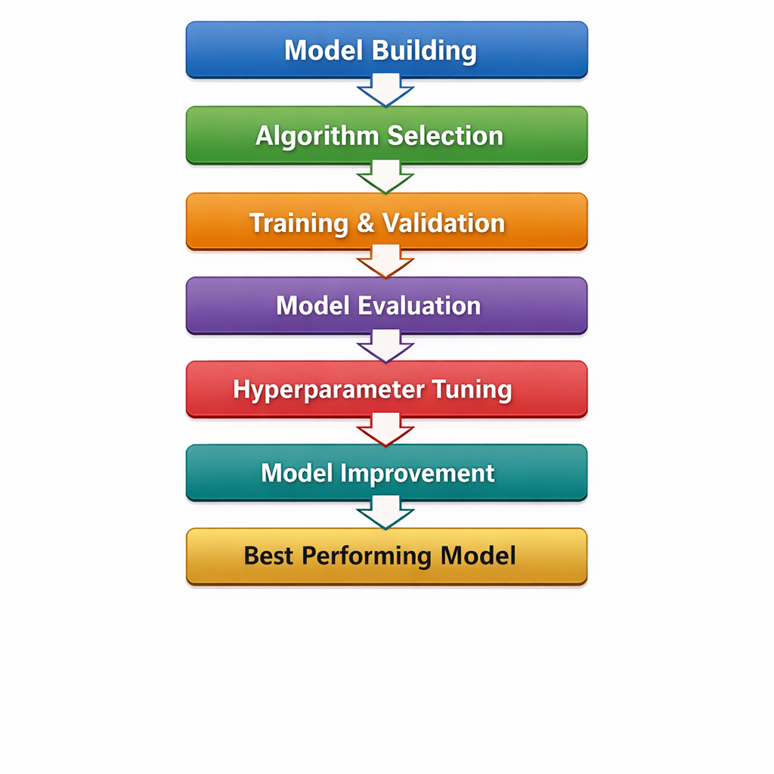
Predictive Analysis (Classification) - Flowchart

Slide 26
Results
1. Data Analysis (Exploratory Data Analysis) Results
Exploratory analysis identified meaningful patterns in launch performance across launch sites, orbit types, and payload mass ranges. Visualizations including scatter plots, bar charts, and line charts revealed variability in success rates by operational location and mission configuration.
Launch site comparisons demonstrated measurable differences in reliability, with certain sites achieving higher overall success ratios.
Payload mass analysis suggested potential relationships between mission complexity and outcome probability, particularly within specific payload ranges.
Yearly success trend analysis showed overall improvement in mission reliability over time, indicating operational learning and system refinement.
2. Interactive Analytics Dashboard Results
The Plotly Dash dashboard enabled real-time exploration of launch data using interactive filters including launch site selection and payload range sliders.
Dynamic pie charts displayed launch success distributions both across all sites and within individual sites, supporting rapid performance comparison.
Interactive scatter plots visualized payload versus launch outcome relationships, allowing users to isolate payload intervals and observe performance patterns.
The integrated visual analytics interface supports data-driven decision-making by combining filtering, visualization, and outcome comparison in a single environment.

Slide 27
Results
Predictive Analysis Results
Exploratory analysis identified meaningful patterns in launch performance across launch sites, orbit types, and payload mass ranges. Visualizations including scatter plots, bar charts, and line charts revealed variability in success rates by operational location and mission configuration.
Launch site comparisons demonstrated measurable differences in reliability, with certain sites achieving higher overall success ratios.
Payload mass analysis suggested potential relationships between mission complexity and outcome probability, particularly within specific payload ranges.
Yearly success trend analysis showed overall improvement in mission reliability over time, indicating operational learning and system refinement.

Slide 28

Section 2

Slide 29
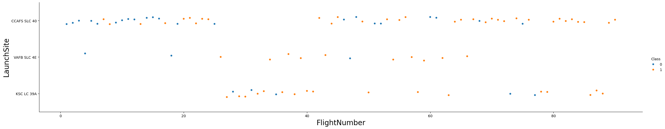
Flight Number vs. Launch Site
Show a scatter plot of Flight Number vs. Launch Site
sns.catplot(y="LaunchSite", x = "FlightNumber", hue = "Class" , data=df, aspect = 5)plt.xlabel("FlightNumber", fontsize=20)plt.ylabel("LaunchSite", fontsize=20) plt.show()
The scatter plot suggests a measurable learning curve, reinforcing the inclusion of launch experience as a predictive variable.

Slide 30
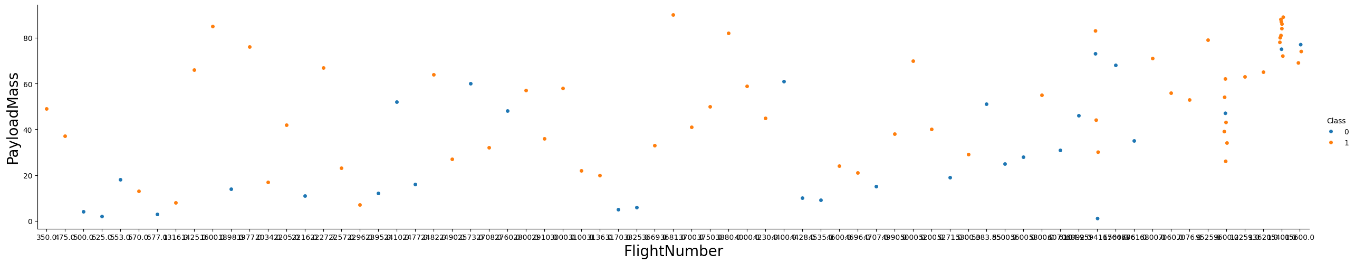
Payload vs. Launch Site
Show a scatter plot of Payload vs. Launch Site
sns.catplot(y="FlightNumber", x = "PayloadMass", hue = "Class" , data=df, aspect = 5)plt.xlabel("FlightNumber", fontsize=20)plt.ylabel("PayloadMass", fontsize=20) plt.show()
The scatter plot compares payload distribution across launch sites, identify site-specific payload specialization patterns and detect payload thresholds that may influence mission outcome.

Slide 31
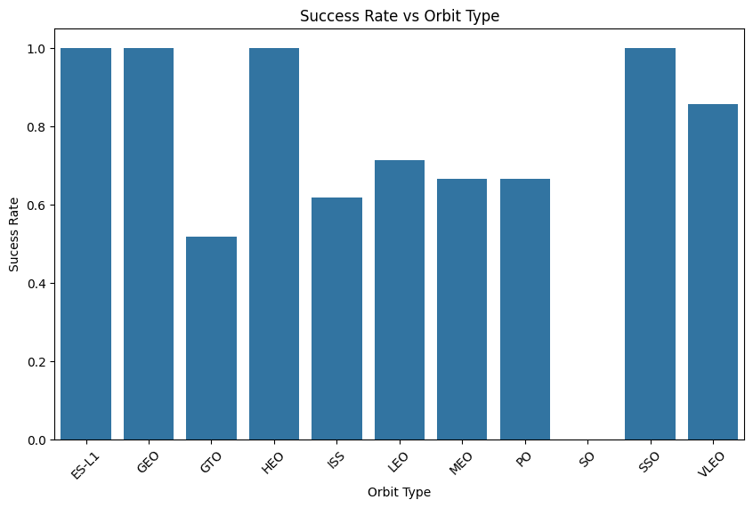
Success Rate vs. Orbit Type
Show a bar chart for the success rate of each orbit type
success_rate = df.groupby("Orbit")["Class"].mean().reset_index()plt.figure(figsize=(10,6))sns.barplot(data=success_rate, x="Orbit", y="Class")plt.title("Success Rate vs Orbit Type")plt.xlabel("Orbit Type")plt.ylabel("Sucess Rate")plt.xticks(rotation=45) plt.show()
The bar chart shows the bar height which represents average success rate for each orbit.

Slide 32
Flight Number vs. Orbit Type
Show a scatter point of Flight number vs. Orbit type
plt.figure(figsize=(10, 6)) # Orbit is categorical, so use a strip plot (scatter-style) rather than a numeric scatter sns.stripplot( data=df, x="FlightNumber", y="Orbit", hue="Class", # 1 = Success, 0 = Failure jitter=True, alpha=0.7 ) plt.title("Flight Number vs Orbit Type") plt.xlabel("Flight Number") plt.ylabel("Orbit Type") plt.legend(title="Mission Outcome", labels=["Failure", "Success"]) plt.show()

Slide 33
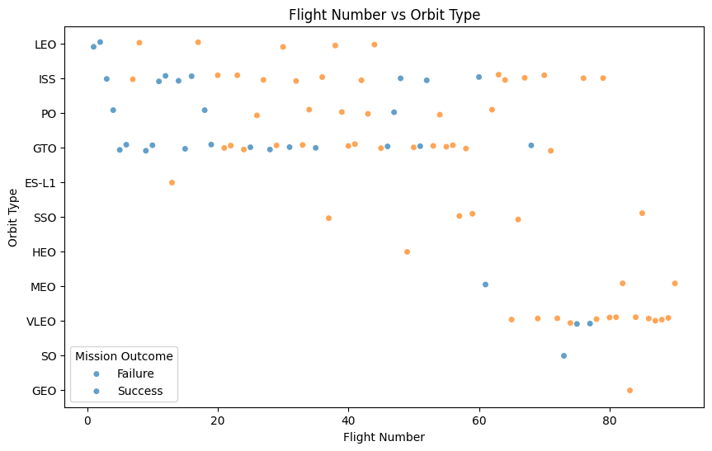
Flight Number vs. Orbit Type
Orbit Type is categorical; a strip plot preserves category labels on the y-axis.
Jitter spreads points so overlapping launches remain visible.
Hue by Class overlays success/failure patterns without requiring separate charts.
Validate whether Orbit Type should be treated as an important categorical feature in predictive modeling.
Support feature engineering decisions.
Identify outliers or rare orbit categories that may require grouping or careful train/test splitting.

Slide 34
Payload vs. Orbit Type
Show a scatter point of payload vs. Orbit type
plt.figure(figsize=(10, 6)) # Orbit is categorical; a box plot summarizes payload distribution per orbit sns.boxplot( data=df, x="Orbit", y="PAYLOAD_MASS__KG_" ) plt.title("Payload Mass vs Orbit Type") plt.xlabel("Orbit Type") plt.ylabel("Payload Mass (kg)") plt.xticks(rotation=45) plt.show()

Slide 35
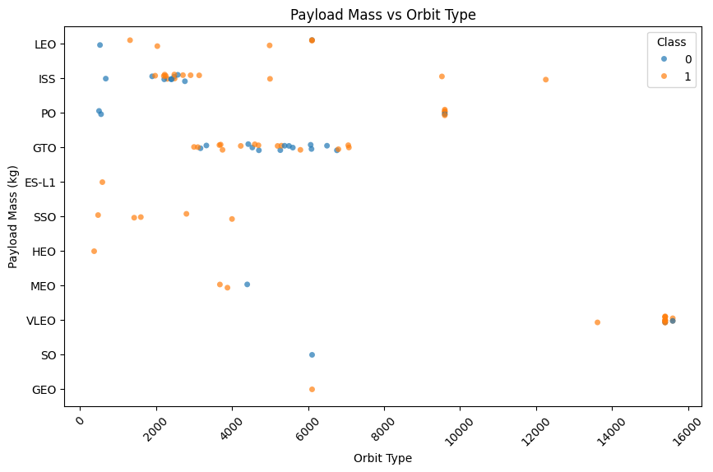
Payload vs. Orbit Type
Assess whether Orbit Type is associated with payload mass differences (mission profile effects).
Support feature engineering decisions (e.g., payload bins; orbit one-hot encoding; orbit–payload interaction).
Identify outliers that may require cleaning or robust scaling before modeling.

Slide 36
Launch Success Yearly Trend
df['Date'] = pd.to_datetime(df['Date'], errors='coerce') df['Year'] = df['Date'].dt.year
Step 2 – Compute Yearly Average Success Rate
yearly_success = ( df.groupby('Year')['Class'] .mean() .reset_index() ) yearly_success.head()
Step 3 – Plot Line Chart
import matplotlib.pyplot as plt plt.figure(figsize=(10,6)) plt.plot( yearly_success['Year'], yearly_success['Class'] ) plt.title("Yearly Launch Success Rate Trend") plt.xlabel("Year") plt.ylabel("Average Success Rate") plt.xticks(yearly_success['Year'], rotation=45) plt.show()

Slide 37
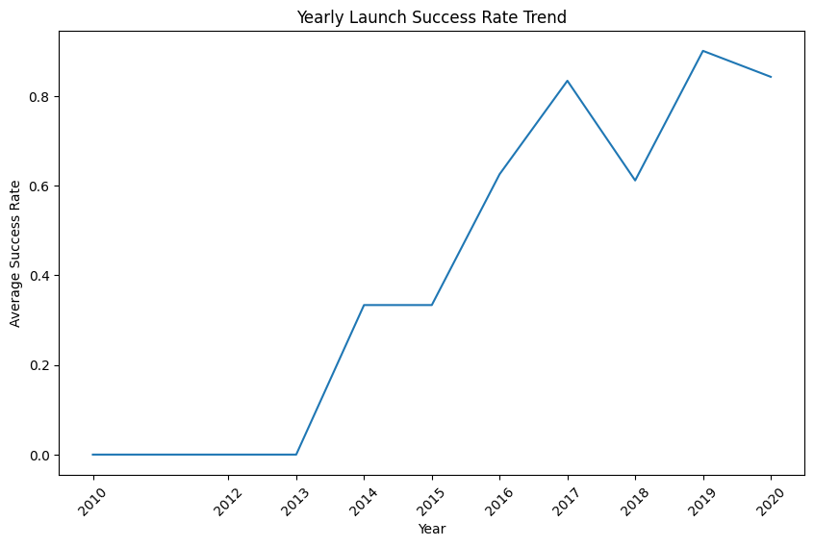
Launch Success Yearly Trend
• Shows reliability progression across years.
• Identifies learning curve effects and operational maturity.
• Detects volatility or stability phases in performance.
• Supports inclusion of temporal features in predictive modeling.

Slide 38
All Launch Site Names
Find the names of the unique launch sites
Query = """ SELECT DISTINCT Launch_site FROM SPACEXTABLEORDER BY Launch_site;"""cur.execute(query)unique_sites = cur.fetchall()unique_sites
Launch_Site [('CCAFS LC-40',), ('CCAFS SLC-40',), ('KSC LC-39A',), ('VAFB SLC-4E',)]

Slide 39
Launch Site Names Begin with 'CCA'
Find 5 records where launch sites begin with `CCA`
Query:
""" SELECT * FROM SPACEXTABLEWHERE Launch_Site LIKE 'CCA%'LIMIT 5; """cur.execute(query)rows = cur.fetchall()df_cca = pd.DataFrame(rows,columns=df.columns)df_cca
Date | Time (UTC) | Booster_Version | Launch_Site | Payload | PAYLOAD_MASS__KG_ | Orbit | Customer | Mission_Outcome | Landing_Outcome
2010-06-04 | 18:45:00 | F9 v1.0 B0003 | CCAFS LC-40 | Dragon Spacecraft Qualification Unit | 0 | LEO | SpaceX | Success | Failure (parachute)
2010-12-08 | 15:43:00 | F9 v1.0 B0004 | CCAFS LC-40 | Dragon demo flight C1, two CubeSats | 0 | LEO (ISS) | NASA (COTS) NRO | Success | Failure (parachute)
2012-05-22 | 7:44:00 | F9 v1.0 B0005 | CCAFS LC-40 | Dragon demo flight C2 | 525 | LEO (ISS) | NASA (COTS) | Success | No attempt
2012-10-08 | 0:35:00 | F9 v1.0 B0006 | CCAFS LC-40 | SpaceX CRS-1 | 500 | LEO (ISS) | NASA (CRS) | Success | No attempt
2013-03-01 | 15:10:00 | F9 v1.0 B0007 | CCAFS LC-40 | SpaceX CRS-2 | 677 | LEO (ISS) | NASA (CRS) | Success | No attempt

Slide 40
Total Payload Mass
Calculate the total payload carried by boosters from NASA
Query:
""" SELECT SUM("PAYLOAD_MASS__KG_") AS total_payload_massFROM "SPACEXTABLE"WHERE Customer = 'NASA (CRS)'; """cur.execute(query)total_payload = cur.fetchone()total_payload
Result:
(45596)

Slide 41
Average Payload Mass by F9 v1.1
Calculate the average payload mass carried by booster version F9 v1.1
Query:
""" SELECT AVG(PAYLOAD_MASS__KG_) ASavg_payload_mass
FROM SPACEXTABLEWHERE Booster_Version LIKE 'F9 v1.1%'; """ cur.execute(query)avg_payload = cur.fetchone()avg_payload
Result:
(2534.6666666666665)

Slide 42
First Successful Ground Landing Date
Find the dates of the first successful landing outcome on ground pad
Query:
""" SELECT MIN(Date) ASfirst_success_ground_pad
FROM SPACEXTABLEWHERE "Landing_Outcome" = 'Success (ground pad)';"""cur.execute(query)first_success = cur.fetchone()first_success
Result:
('2015-12-22',)

Slide 43
Successful Drone Ship Landing with Payload between 4000 and 6000
List the names of boosters which have successfully landed on drone ship and had payload mass greater than 4000 but less than 6000
Booster Version
F9 FT B1022
F9 FT B1026
F9 FT B1021.2
F9 FT B1031.2

Slide 44
Total Number of Successful and Failure Mission Outcomes
Calculate the total number of successful and failure mission outcomes
Mission_Outcome | Count
Failure (in flight) | 1
Success | 98
Success | 1
Success (payload status unclear) | 1

Slide 45
Boosters Carried Maximum Payload
List the names of the booster which have carried the maximum payload mass
Booster_Version | PAYLOAD_MASS_KG
F9 B5 B1048.4 | 15600
F9 B5 B1049.4 | 15600
F9 B5 B1051.3 | 15600
F9 B5 B1056.4 | 15600
F9 B5 B1048.5 | 15600
F9 B5 B1051.4 | 15600
F9 B5 B1049.5 | 15600
F9 B5 B1060.2 | 15600
F9 B5 B1058.3 | 15600
F9 B5 B1051.6 | 15600
F9 B5 B1060.3 | 15600

Slide 46
2015 Launch Records
List the failed landing_outcomes in drone ship, their booster versions, and launch site names for in year 2015
Month | Booster_Version | Landing_Outcome | Launch_Site
01 | F9 v1.1 B1012 | Failure (drone ship) | CCAFS LC-40
04 | F9 v1.1 B1015 | Failure (drone ship) | CCAFS LC-40

Slide 47
Rank Landing Outcomes Between 2010-06-04 and 2017-03-20
Rank the count of landing outcomes (such as Failure (drone ship) or Success (ground pad)) between the date 2010-06-04 and 2017-03-20, in descending order
Landing_Outcome1 | Count
No attempt | 10
Success (drone ship) | 5
Failure (drone ship) | 5
Success ( ground pad) | 3
Controlled (ocean) | 3
Uncontrolled (ocean) | 2
Failure (parachute) | 2
Precluded (drone ship) | 1

Slide 48

Section 3

Slide 49
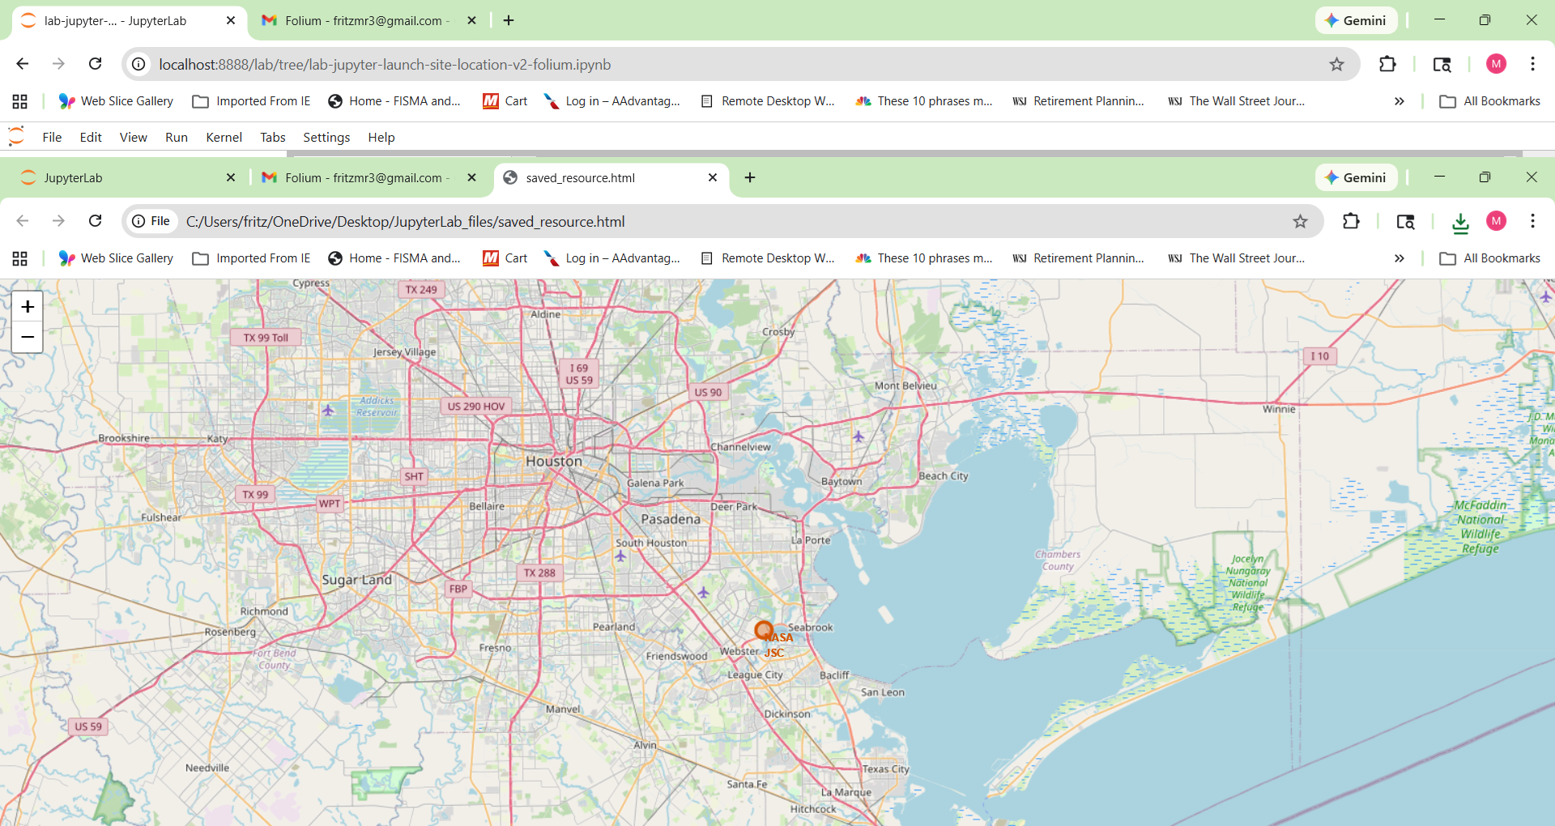
All Launch Site on the Map
Explore the generated folium map and make a proper screenshot to include all launch sites’ location markers on a global map

Slide 50
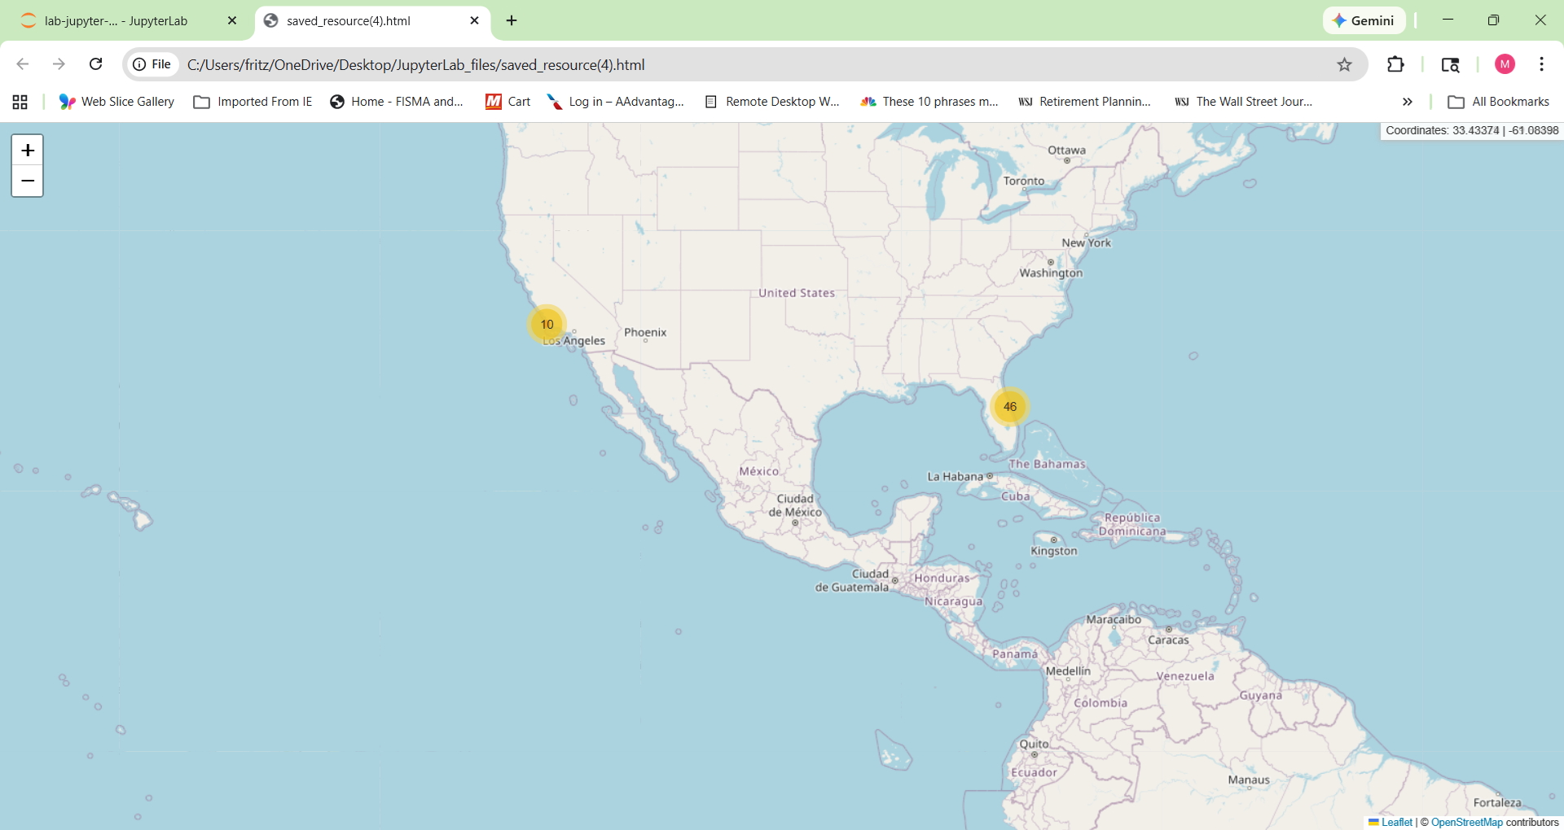
Mark the success/failed launches for each site on the map

Slide 51
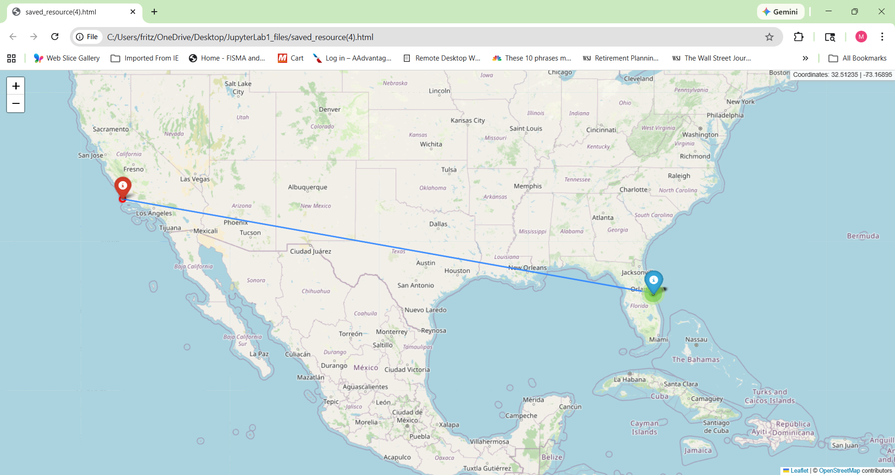
Calculate the distances between a launch site - proximities

Slide 52

Section 4

Slide 53
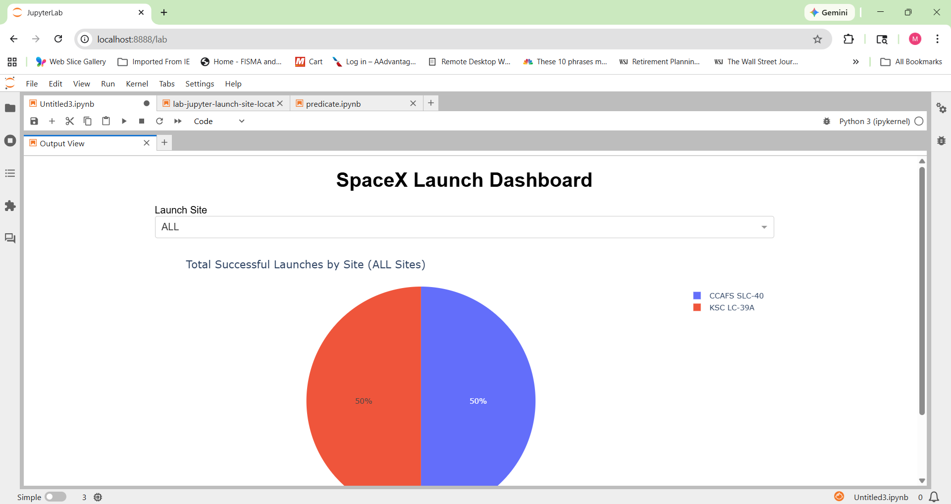
Launch success count for all sites, in a pie chart

Slide 54
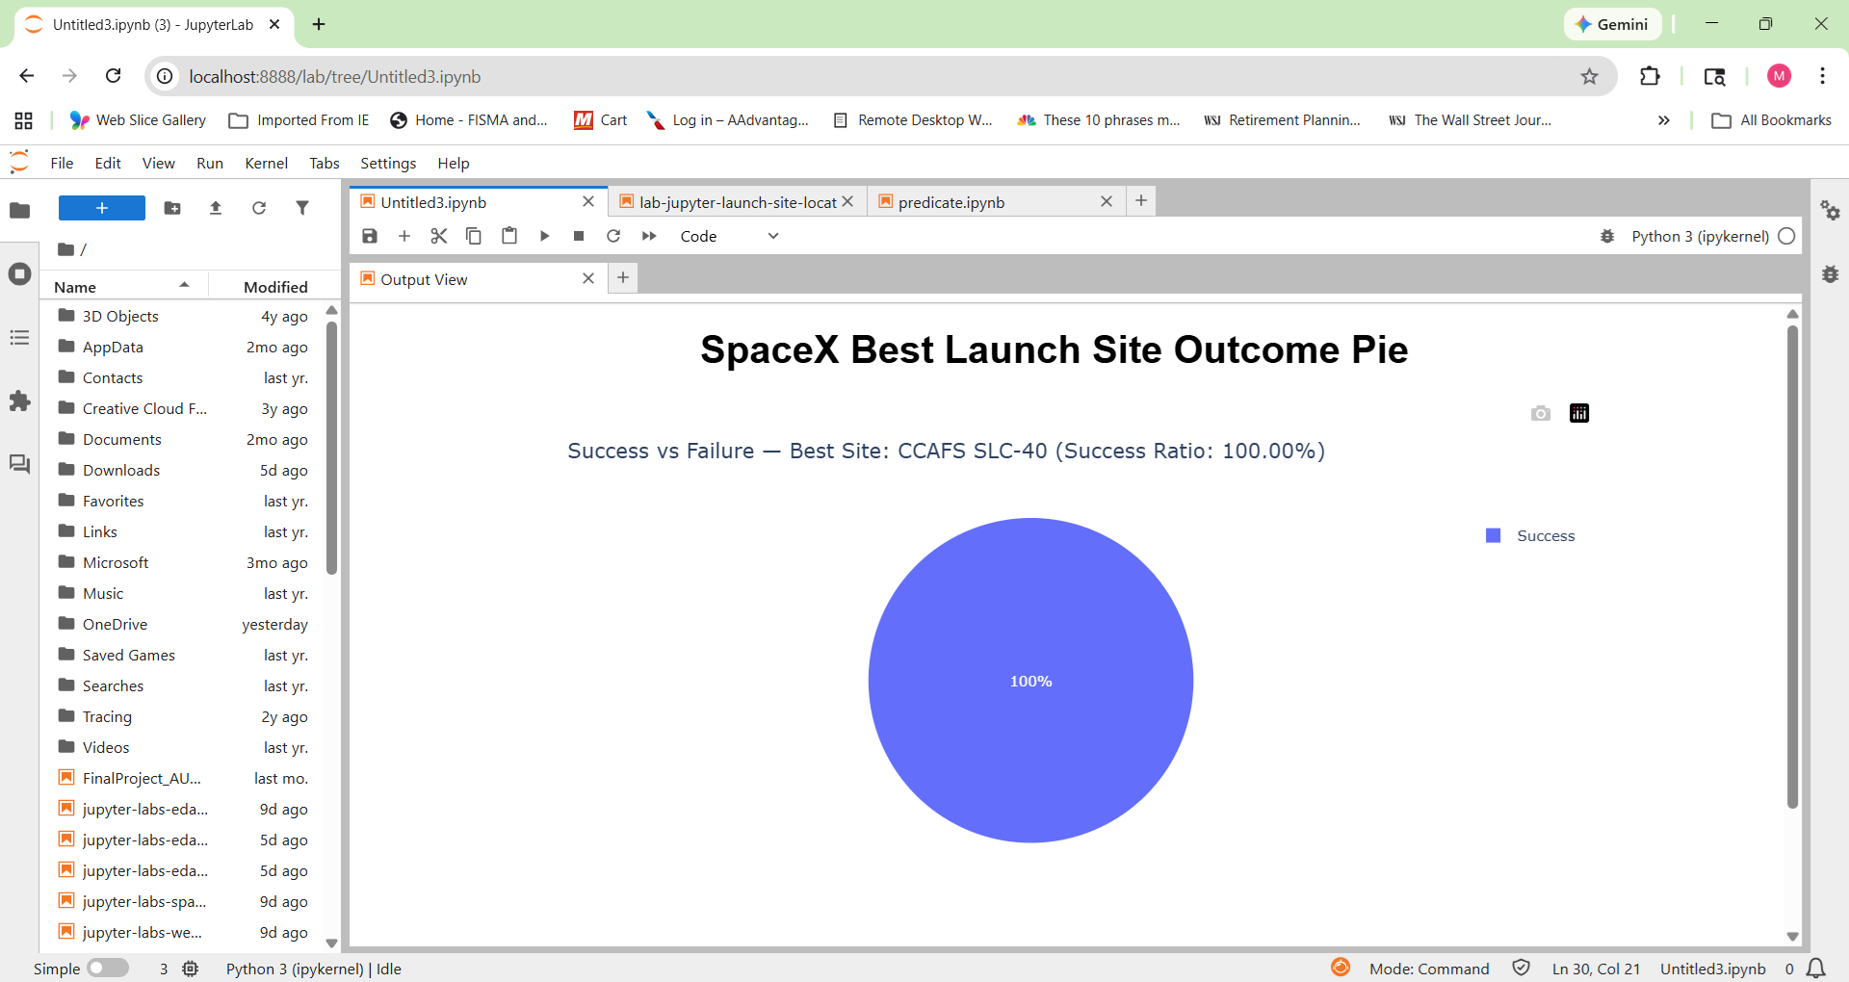
Pie chart for the launch site with highest launch success ratio

Slide 55
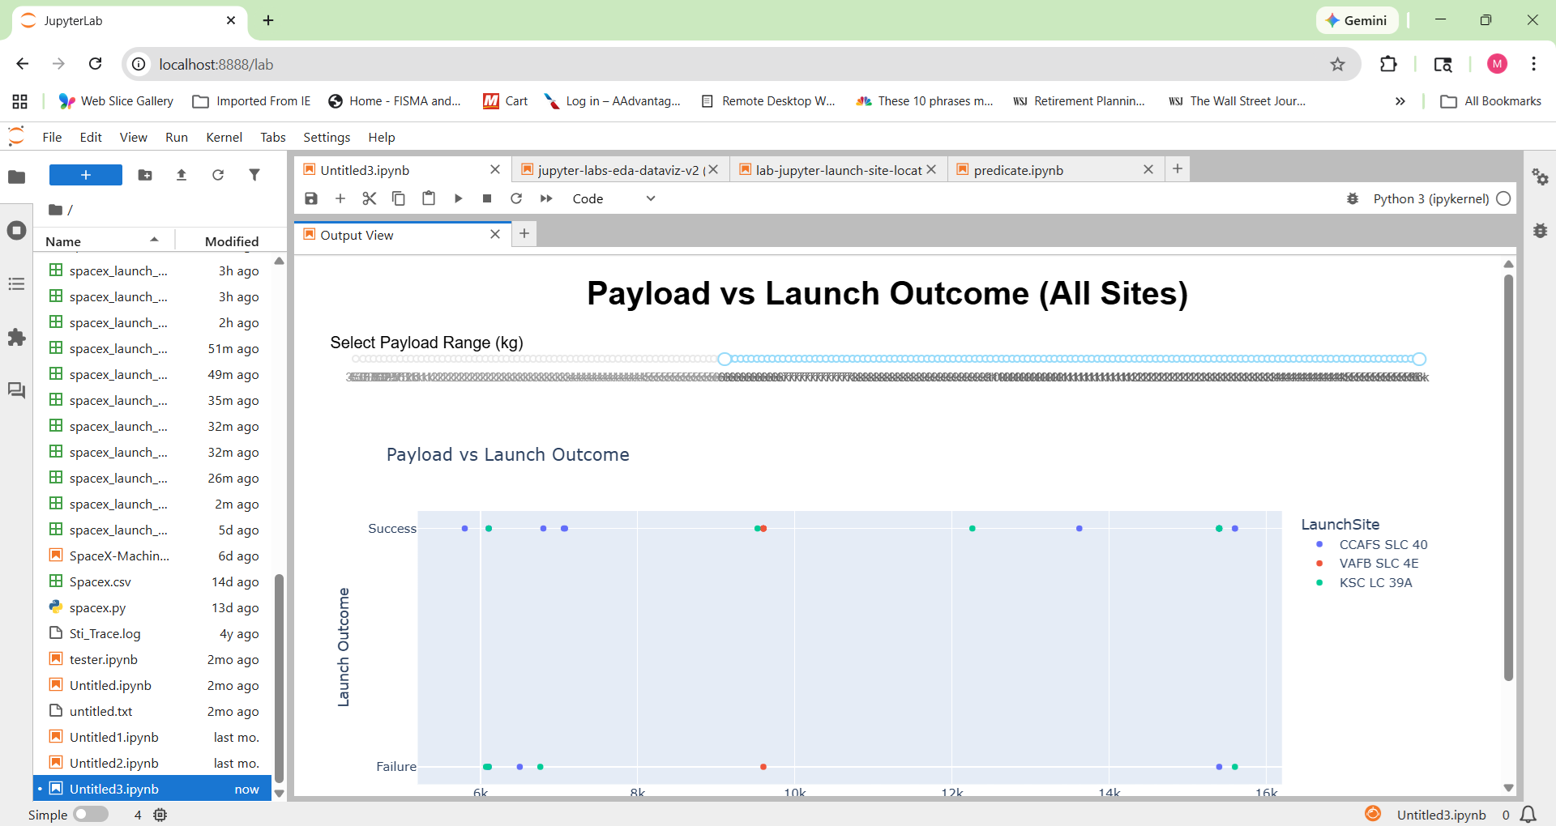
Payload vs. Launch Outcome scatter plot for all sites

Slide 56

Section 5

Slide 57
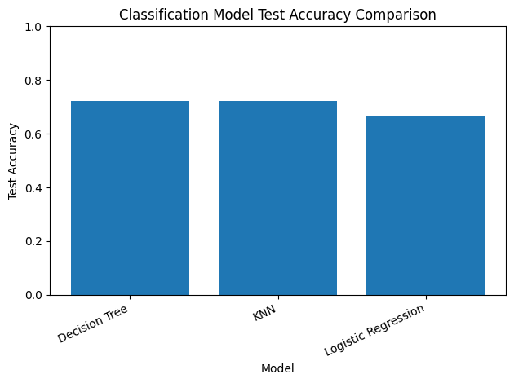
Classification Accuracy

Slide 58
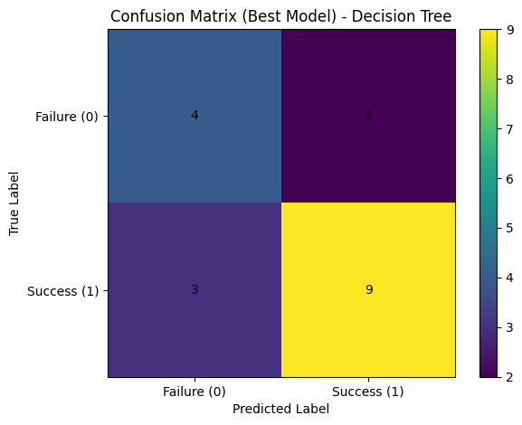
Confusion Matrix

Slide 59
Conclusions
1. Launch Site Performance Varies Significantly
Analysis revealed measurable differences in launch success ratios across launch sites. Certain sites consistently demonstrated higher reliability, suggesting operational, environmental, or infrastructure factors influence mission outcomes.
2. Payload Mass Influences Launch Outcomes
Exploratory analysis identified observable patterns between payload mass and mission success. Different payload ranges exhibited varying performance distributions, indicating mission complexity and vehicle load contribute to risk variability.
3. Predictive Models Demonstrate Strong Performance
Multiple classification algorithms (Logistic Regression, Decision Tree, KNN) were trained and optimized using GridSearch. The best-performing model achieved strong test accuracy and demonstrated reliable predictive capability using payload, orbit, and launch site features.
4. Interactive Dashboard Enables Data-Driven Insights
The integrated Plotly Dash application combines filtering, visualization, and predictive modeling. This provides a practical decision-support tool for evaluating launch configurations, assessing mission risk, and identifying high-performing operational sites.
https://github.com/gopikrishnan-t-s/Applied-Data-Science-Capstone

Slide 60
Innovative Insights
Operational Learning Curve Impact
Analysis of multi-year launch data indicates a clear upward trend in mission success rates, reflecting measurable operational maturation. The results suggest that sustained launch cadence, process refinement, and accumulated engineering experience significantly enhance reliability over time.
This finding reinforces the strategic value of continuous execution, data-driven performance monitoring, and iterative improvement as core drivers of long-term mission success.
In practical terms, reliability growth appears to be organizationally cultivated rather than purely hardware-dependent, demonstrating the competitive advantage of disciplined operational learning.

Slide 61


